Slide 1
COMMERCIAL FIRM MANAGER
RAHUL CHAPLOT 140040066
VINAYAK SUTHAR 140040036
SHUBHAM PATIL 14D170015

Slide 2
Problem Statement
1. We choose Commercial Firm Manager as our software project so as to apply the most of what we have learned in the lectures. For example, the use of class,inheritance,use of strings and the advanced use of most basic functions like loops,initCanvas,.
2. We also aimed to learn new concepts such as data file handling,advanced Canvas Functions.
3. We wish to provide a complete package of raw stock management, manufactured stock management, selling management and billing function with profit analysis function.

Slide 3
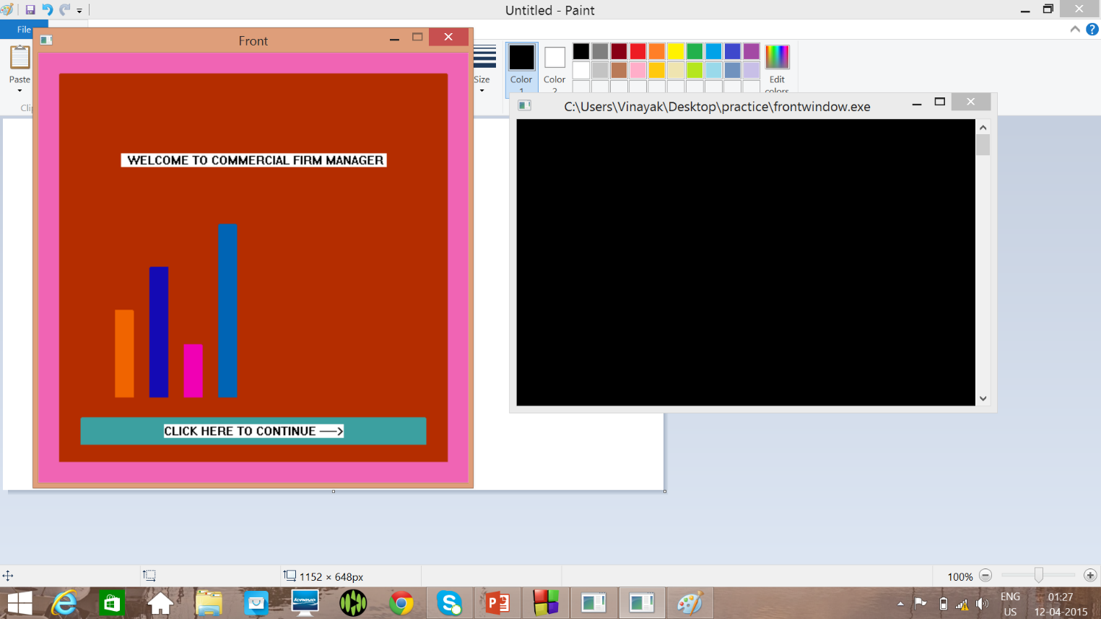

Slide 4
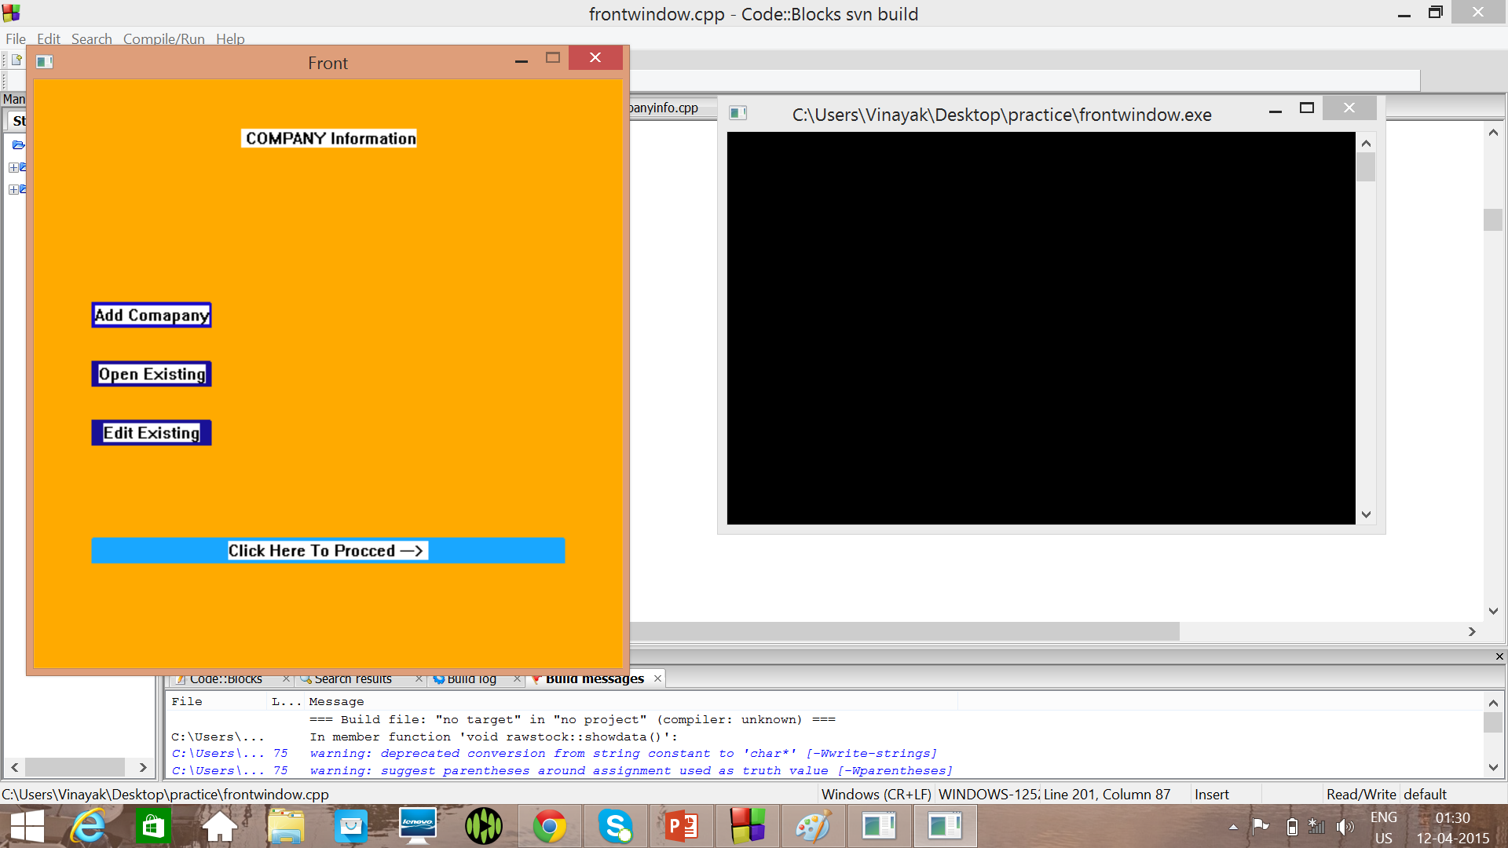

Slide 5
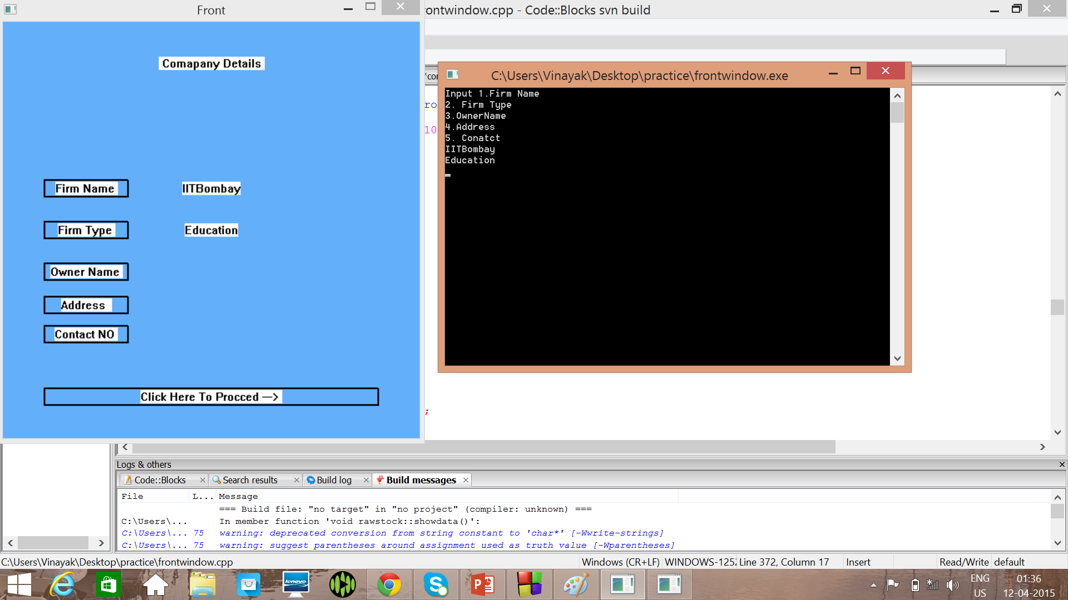

Slide 6
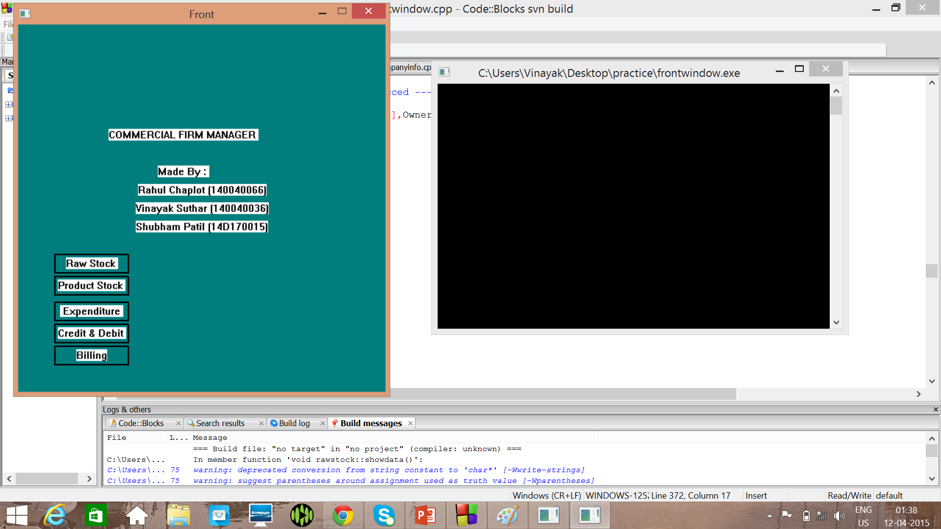

Slide 7
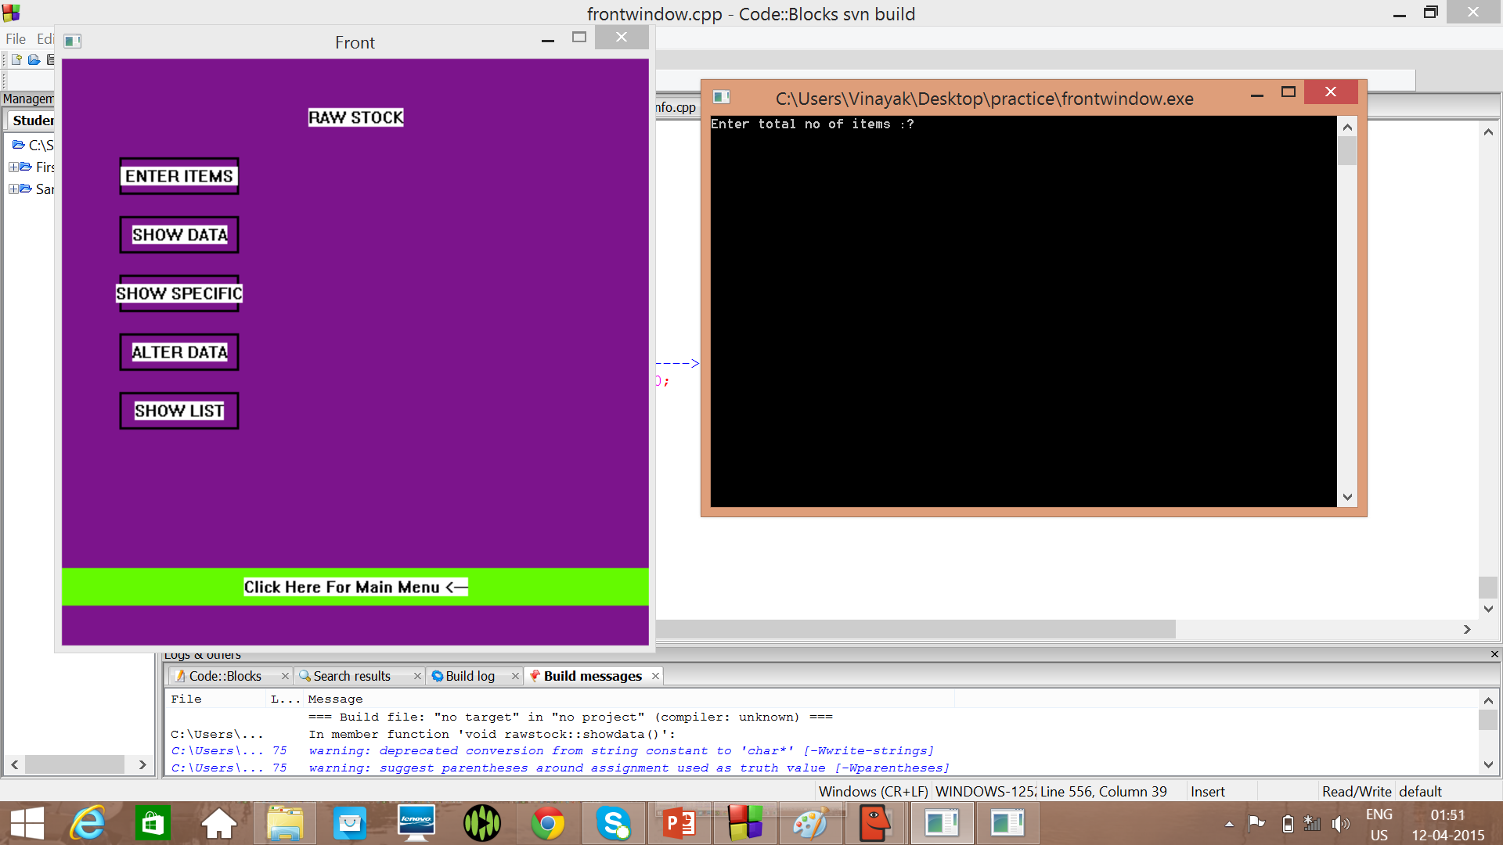

Slide 8
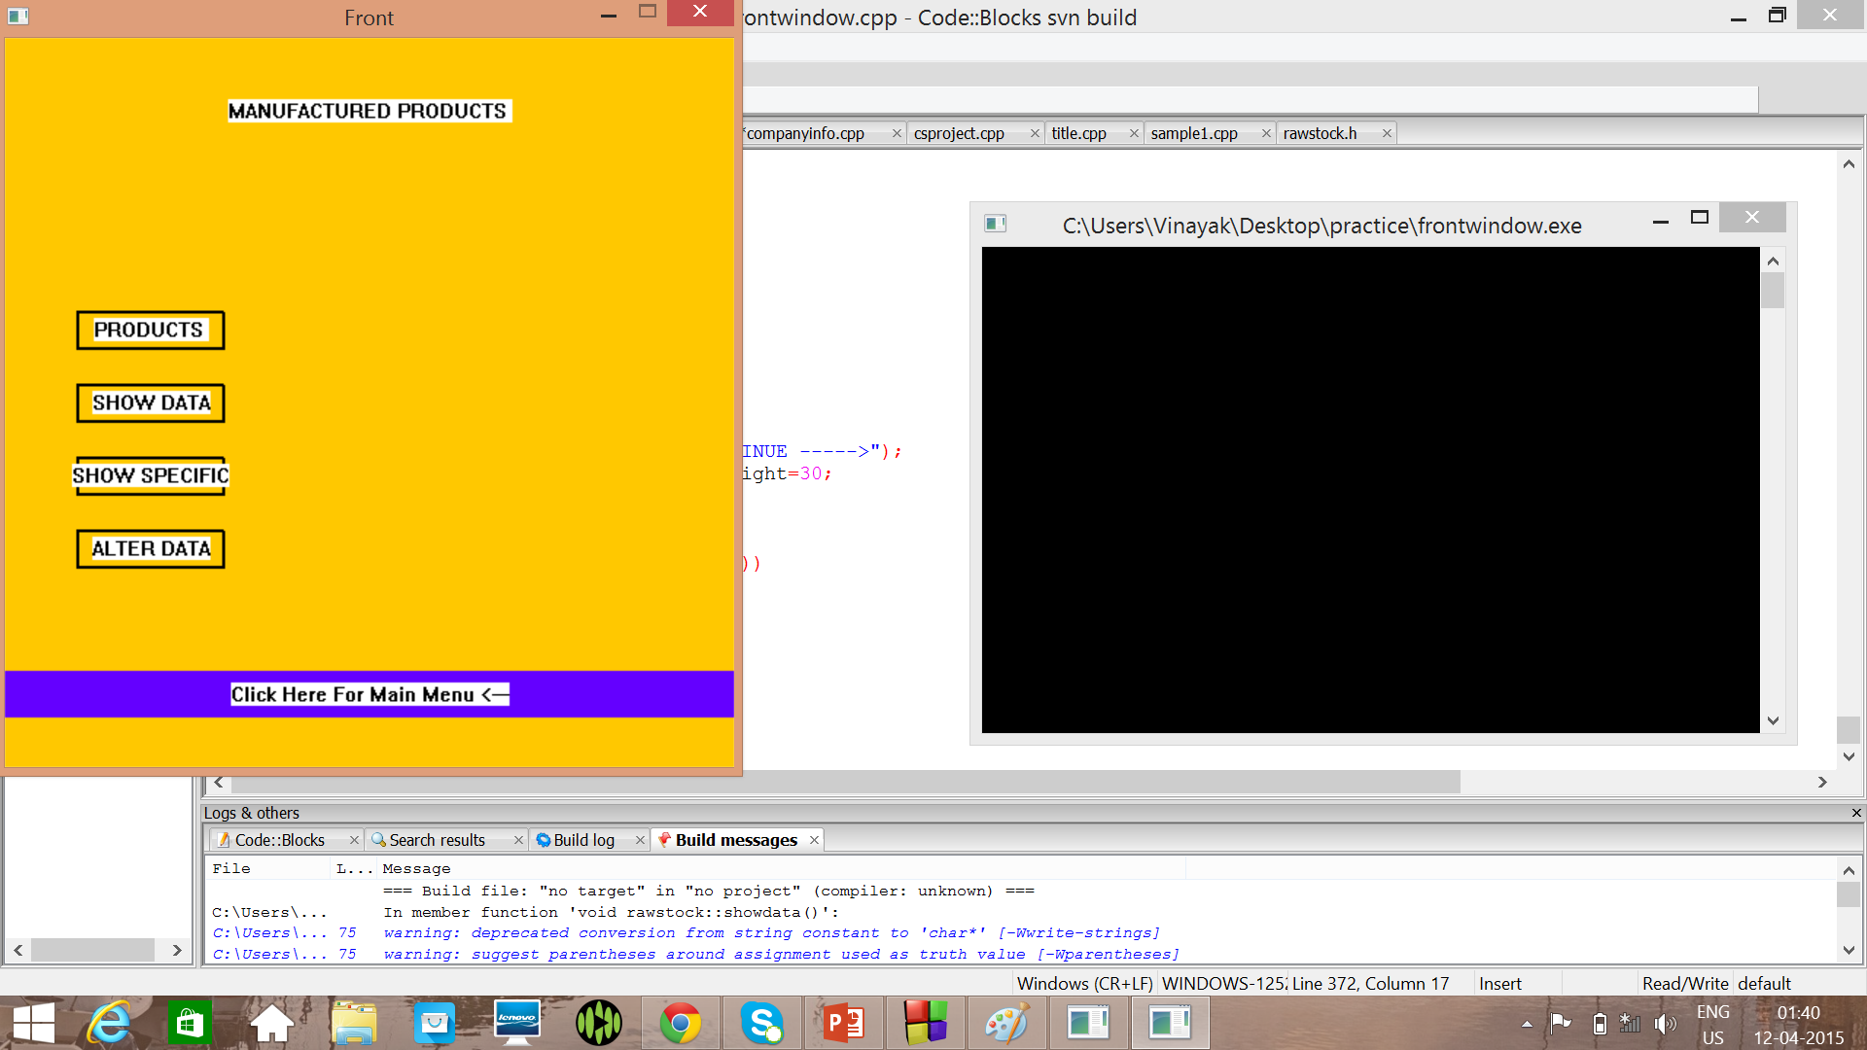

Slide 9
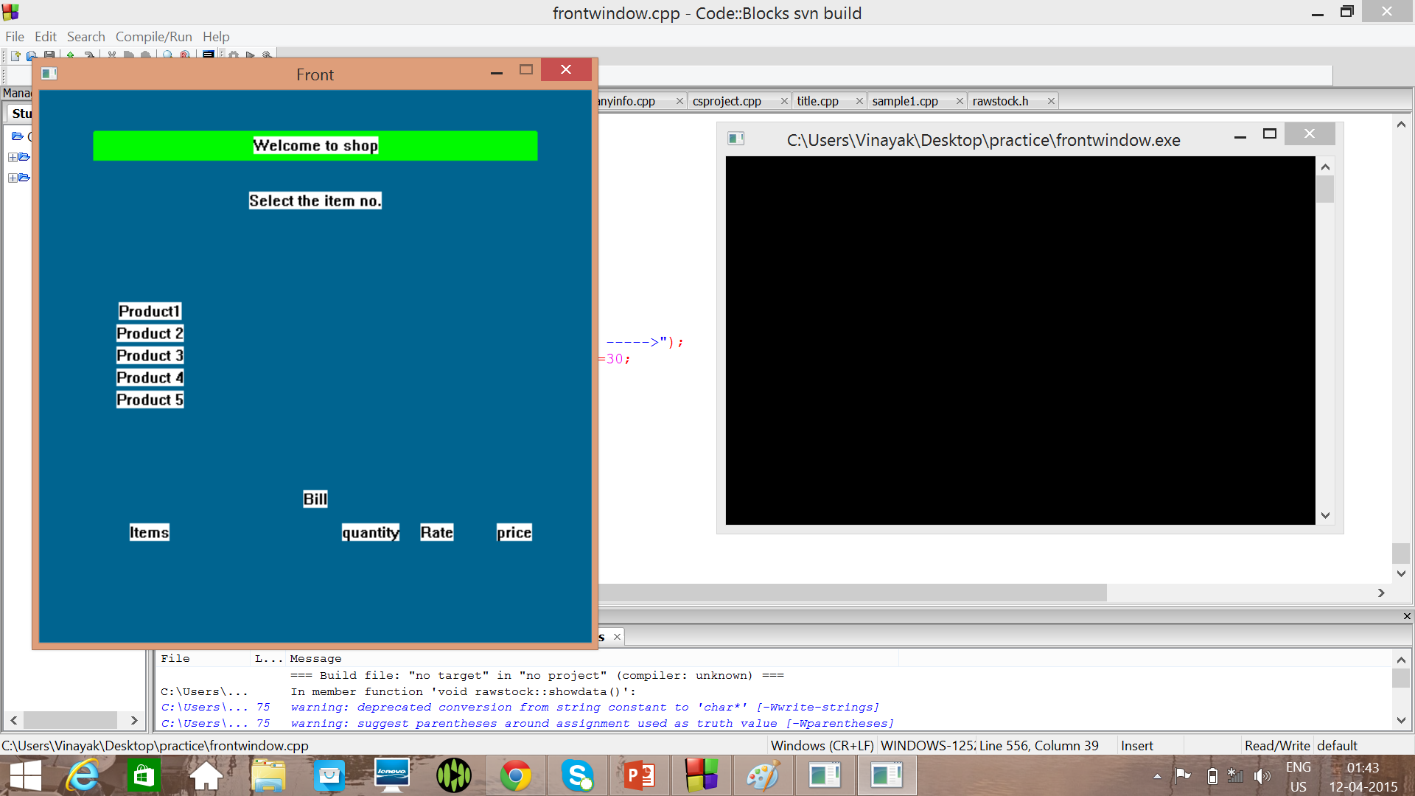

Slide 10
Challenge
1. After completing the basic operations of the program,it was difficult to perform switching of Canvas windows and generate desired ouput on Canvas.
After discussion with TA we learnt new methods to tackle data file handling of binary files and more canvas functions.

Slide 11
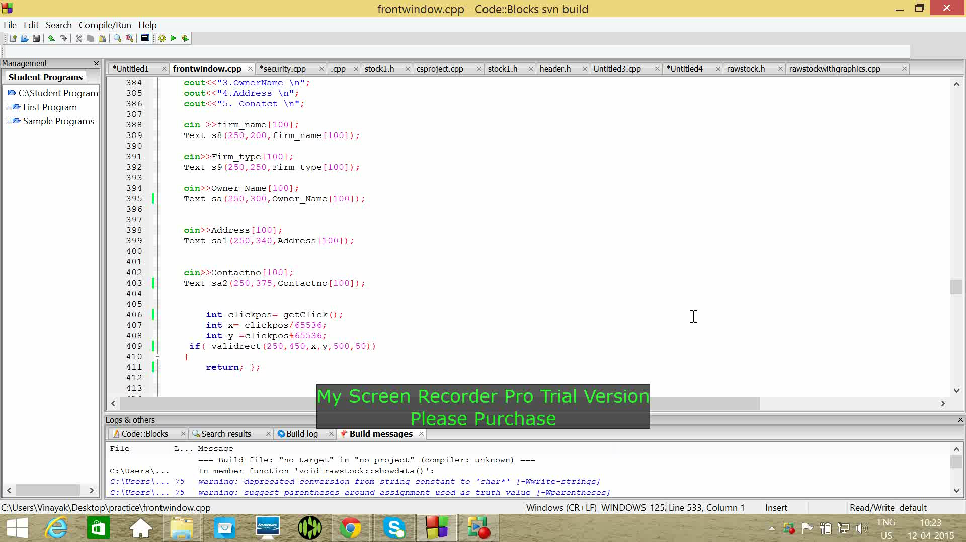

Slide 12
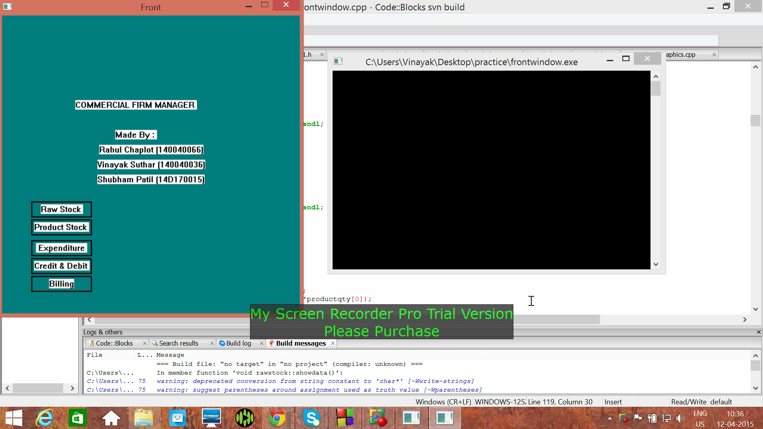

Slide 13
Future Work
1. The software can be extended with labour management .
2. The software can be extended to use it for online shopping system for selling the products made in firm.
3.Currently it is single computer based
software but can be extended to a server or network based software.

Slide 14
INNOVATIONS
A Complete package of managing software with raw stock management, manufactured products management, selling management along with billing function and profit analysis.
Different Department can update their work simultaneously and an admin can look out work of each department and can manage them.
We used mostly Canvas based program to make it more user friendly rather typical Command Prompt.

Slide 15
THANK YOU

